Slide 1




DataDriven Stays
Crafting Strategies for Success in the European Airbnb Market
Team A4 – Julia Ungvary, Anna Vasconcelos, Cole Whittington
Notes:
Julia

Slide 2


Agenda
01
Introduction and Dataset
02
Guest Satisfaction - Methodology and Analysis
03
Price Prediction - Methodology and Analysis
04
Recommendation Strategies and Improvements
Notes:
Julia

Slide 3


Introduction and Dataset
Notes:
Julia

Slide 4




1
Introduction
Initial Ideas and Thoughts
Airline Satisfaction
Boston Real Estate
Predict what factors influence satisfaction
Help investors assess what properties to invest in
Customer Personality
Airbnb
Understand how customer personalities impact purchase behavior
Assist Airbnb owners in ways to maximize revenue
Notes:
Julia

Slide 5



1
Introduction
Project Goals & Questions
Goal: Maximize Profit by Increasing Price and Guest Satisfaction
Objective Question 1
1
What are the most important features when classifying Airbnb listings with high guest satisfaction?
Objective Question 2
2
Which features should be focused when deciding on the appropriate price of Airbnb listings?
Objective Question 3
3
How can Airbnb owners use this analysis to improve their business and choose investment properties?
Notes:
Julia

Slide 6


1
Dataset
Dataset at a Bird’s Eye View
41,000 Observations
19 Dimensions
9 Cities Analyzed
Amsterdam, Athens, Barcelona, Berlin, Budapest, Lisbon, Paris, Rome, Vienna
Guest Satisfaction
Price
Notes:
Julia

Slide 7
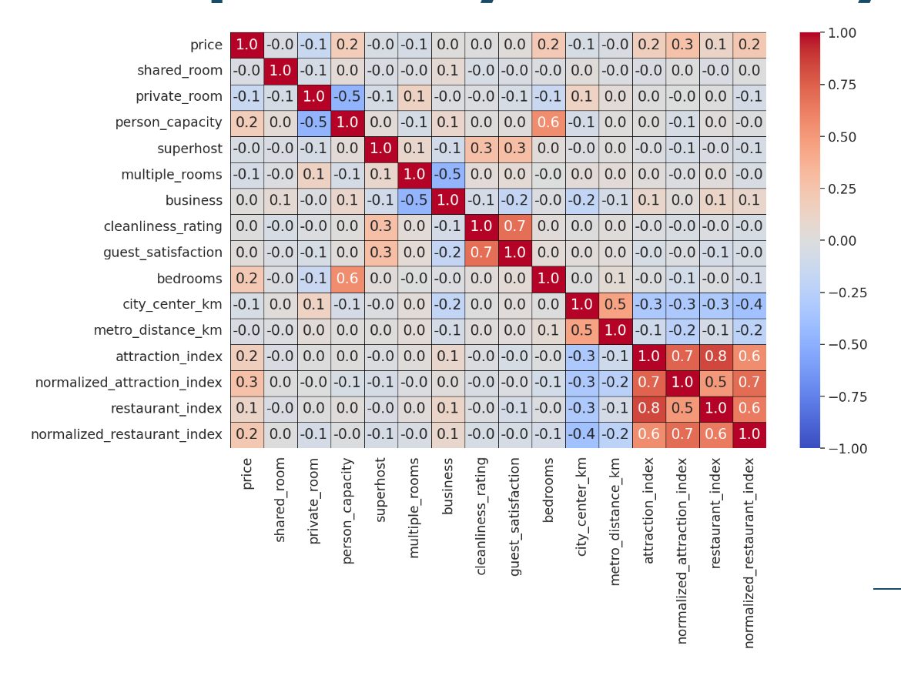
1
Dataset
Exploratory Data Analysis
Initial Dependencies for Further Exploration
Attraction Index and Restaurant Index
Cleanliness and Guest Satisfaction
Person Capacity and Bedrooms
Notes:
Julia – feature correlations

Slide 8
Guest Satisfaction: Methodology and Analysis
Notes:
cole

Slide 9
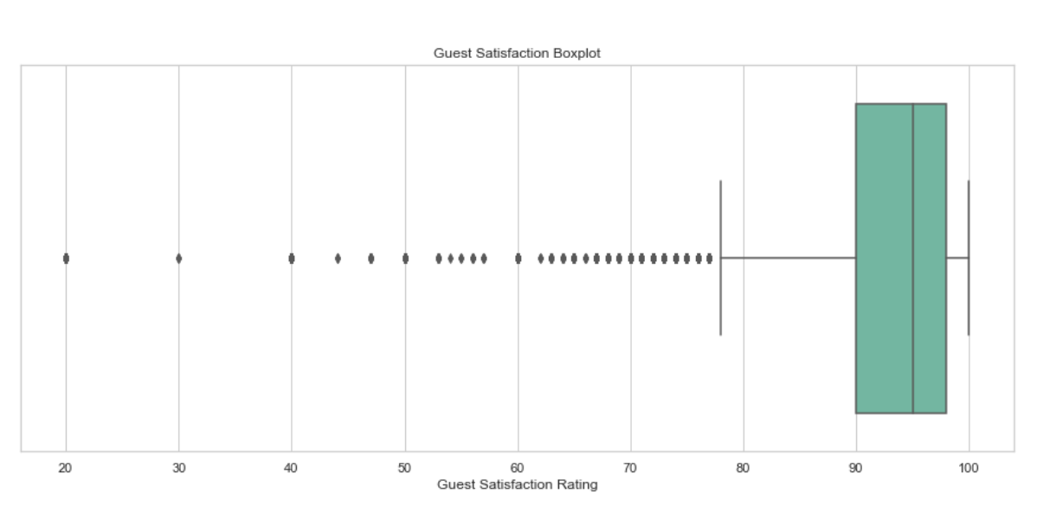
2
Guest Satisfaction
Guest Satisfaction Feature
About the Feature: Ratings were on a scale from 0-100 with 100 being the best score
Important Decision: Deciding how many classes to split this feature into
Visual Representation: The feature is highly skewed left with a mean of 93 and a 25th percentile of 90
Initial Implementation: Three classes led to a low accuracy score on the first K-Nearest Neighbors model
Final Strategy: Two classes
High Satisfaction: score >= 98
Not High Satisfaction: score < 98
Notes:
cole

Slide 10
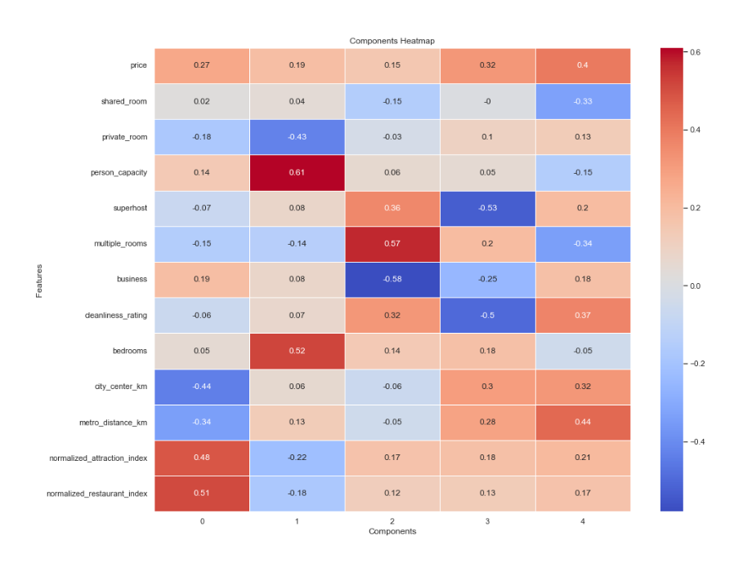
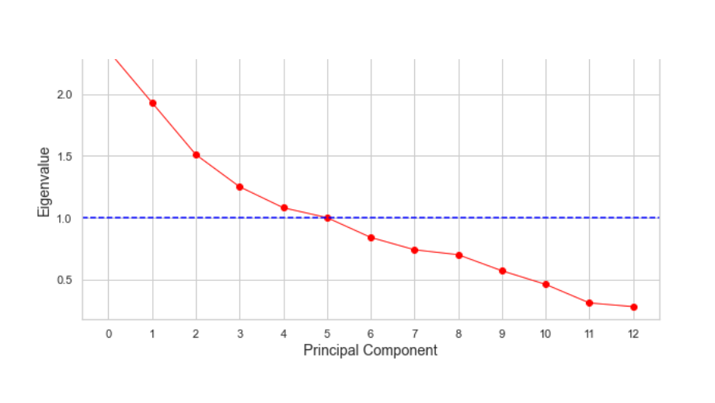

2
Guest Satisfaction
Principal Component Analysis
Why?
To improve computational efficiency, reduce noise, and resolve collinearity issues with models such as Logistic Regression and K-Nearest Neighbors
How?
The dimension reduction algorithm reduced the dataset from 13 metric variables to 5 metric variables
Notes:
cole

Slide 11
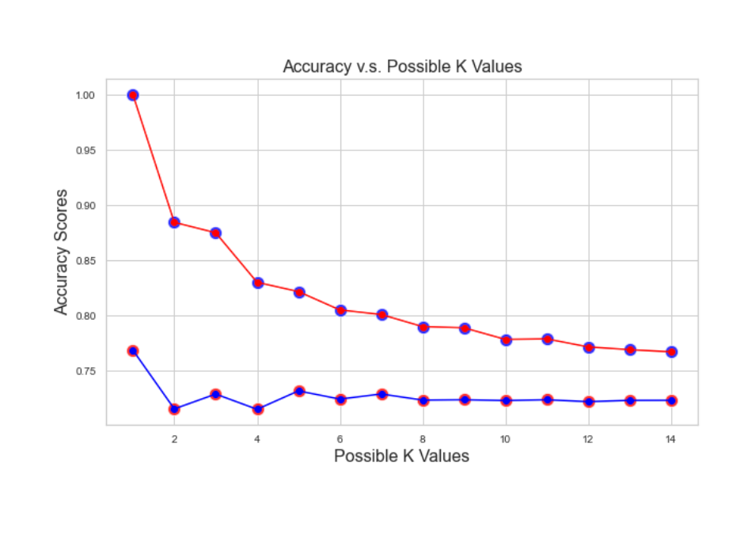
2
Guest Satisfaction
K-Nearest Neighbors Model
Method: To find the k value that would score the highest, fourteen models were run with k values ranging from 1 to 14
Top Performer: The model with a k value equal to 1, but this model overfit the training data
Graph: In general, the graph shows that for higher values of k, the accuracy score is lower than smaller values
Interesting Discovery: Even values of k performed worse than odd values
PCA Trained Data: Using the same methodology, fourteen models were run using the reduced dataset and for each corresponding k value, the accuracy score was slightly lower
Notes:
cole

Slide 12
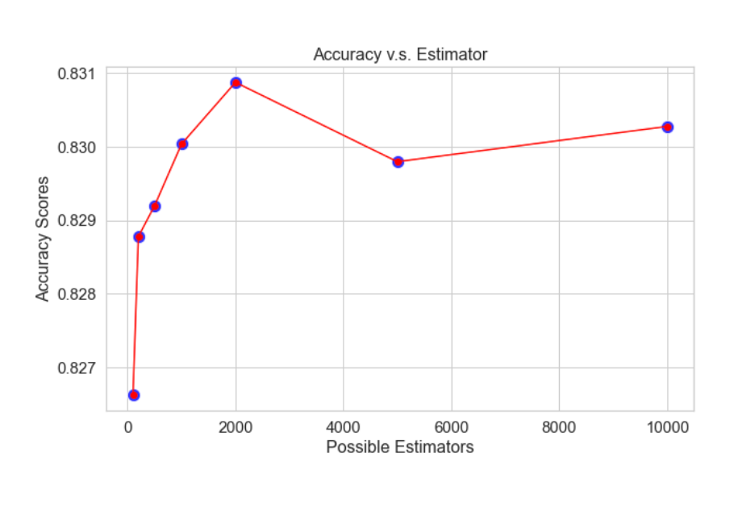
2
Guest Satisfaction
Random Forest Model
Method: To find the number of estimators that would score the highest, seven models were ran with different estimator values
Top Performer: The model with 2000 estimators with an accuracy of 83.08%
Graph: In general, the graph shows an accuracy peak at 2000 estimators
Further Analysis: It is possible that estimator values above 10,000 would lead to higher accuracy scores as the graph seems to be trending upwards. However, this would take extensive time to compute.
Notes:
cole

Slide 13
2
Guest Satisfaction
Comparing Predictive Power
Model Type
Parameters
Accuracy
Random Forest
N_estimators = 2000
83.08%
Top Performer: The random forest model with 2000 estimators as a parameter with an 83.08% accuracy score.
Overfitters: The decision tree model with an accuracy of 77.5% on the testing data but a 100% accuracy on the training data.
Worst Performers: The decision tree with arbitrary parameters scored equal to the naive rule at 67.44%.
Decision Tree
none/full tree
77.50%
KNN
n=1
77.16%
KNN (PCA)
n=11
74.97%
Decision Tree
Max_depth =20,
Minimum_sample_leaf = 100,
Minimum_impurity_decrease = 0
72.84%
Logistic Regression
72.44%
none
Logistic Regression (PCA)
none
70.19%
Naive Rule
n/a
67.44%
Max_depth =10, Minimum_sample_split = 40,
Minimum_sample_leaf = 20,
Minimum_impurity_decrease = 0.01
Decision Tree
67.44%
Notes:
cole

Slide 14
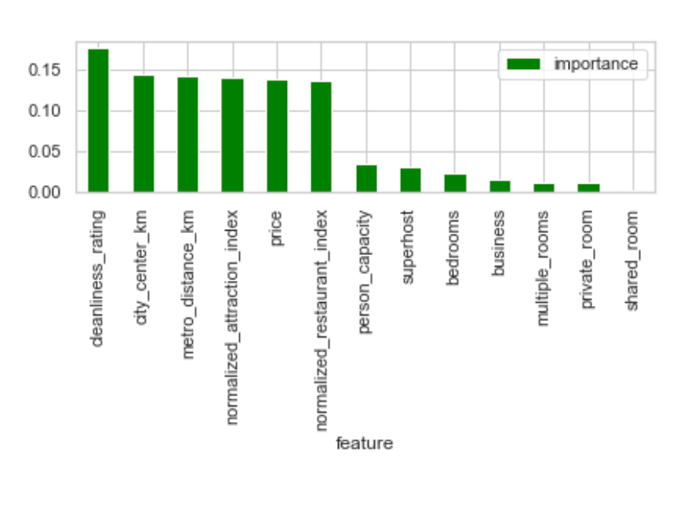
2
Guest Satisfaction
Important Features on best model
Model: Random forest model with 2000 estimators
Most Important Feature: Cleanliness Rating
Other Important Features:
Distance to the city center
Distance to the nearest metro station
Normalized Attraction Index
Price
Normalized Restaurant Index
Irrelevant Features:
Multiple rooms
Private Room
Shared Room
Notes:
cole

Slide 15

2
Guest Satisfaction
Case Study Guest Satisfaction
Meet Brandon!
Brandon wants to invest in a property to rent on Airbnb. He has a goal of having the highest guest satisfaction rating for his listing.
He is choosing between two European properties and needs our help!
Notes:
Julia

Slide 16

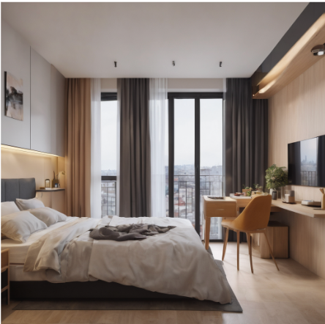

2
Guest Satisfaction
Case Study Guest Satisfaction
1
2
Fancy Apartment in the Heart of the City
Studio Apartment with 800 square feet
Apartment building located on top of restaurants
The closest metro station is a block away
Appeared to be very clean
Low capacity
Quiet Rustic Mansion
House with 5500 square feet
8 private bedrooms (high capacity)
Appeared to be a little dirty
Far from the city center
Over 10 km from closest metro station
No restaurants nearby
Notes:
Julia

Slide 17



2
Guest Satisfaction
Case Study Guest Satisfaction
Features entered into our recommendation algorithm
Property 1 Predicted Guest Satisfaction:
High Satisfaction
1
Features entered into our recommendation algorithm
Property 2 Predicted Guest Satisfaction:
Not High Satisfaction
2
Recommendation: Invest in property one for high guest satisfaction
Notes:
cole

Slide 18
Price Prediction: Methodology and Analysis

Slide 19

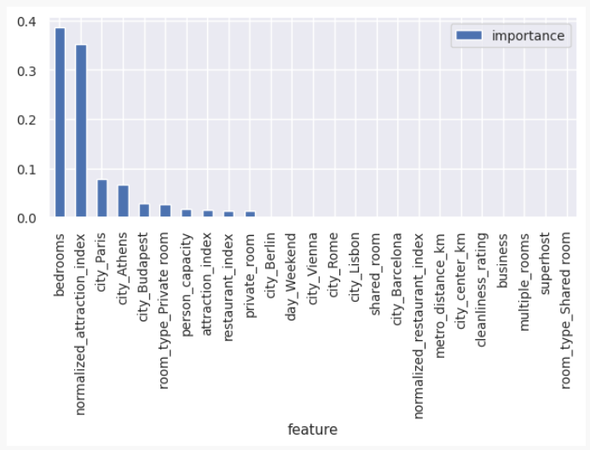
3
Price Prediction
Initial Implementation
Initial Full Regression Tree
RMSE = $300
R2 = 0.14
Preprocessing
Names all have similar composition
Only one tree made
Dummy Coded categorical variables

Slide 20
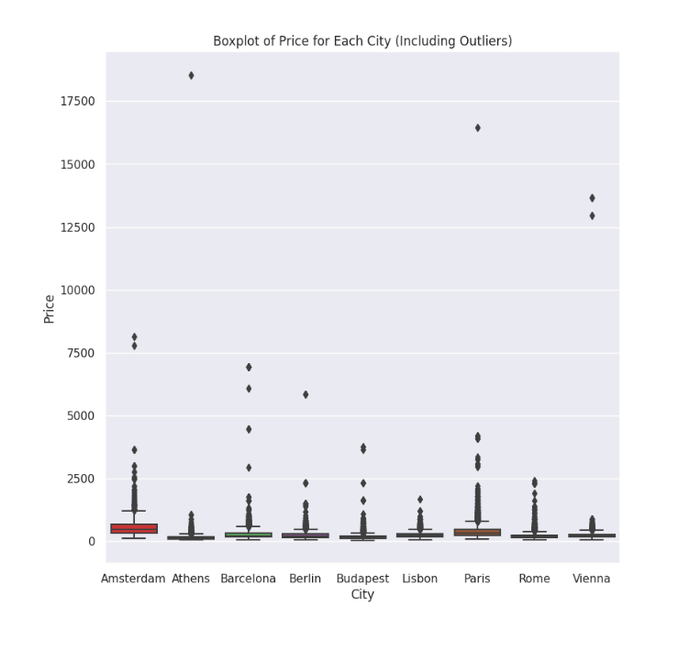
3
Price Prediction
Initial Implementation
City
Mean Price ($)
Price Range ($)
Amsterdam
573.11
8001.78
Athens
151.75
18502.57
Barcelona
293.75
6874.11
Berlin
244.58
5792.51
Budapest
176.51
3716.45
Lisbon
238.21
1610.46
Paris
392.53
16352.88
Rome
205.39
2372.29
Vienna
241.58
13600.73

Slide 21
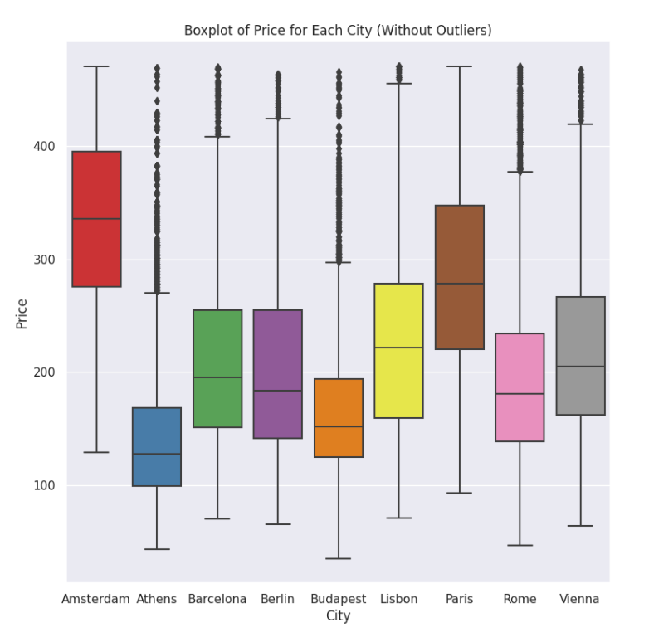
3
Price Prediction
Outlier Detection Revised Approach
City
Mean Price ($)
Price Range ($)
Amsterdam
354.11
397.21
Athens
144.35
479.76
Barcelona
227.11
456.86
Berlin
211.99
481.04
Budapest
167.49
3716.45
Lisbon
230.25
455.68
Paris
299.22
434.57
Rome
197.23
490.91
Vienna
21.75
461.63

Slide 22
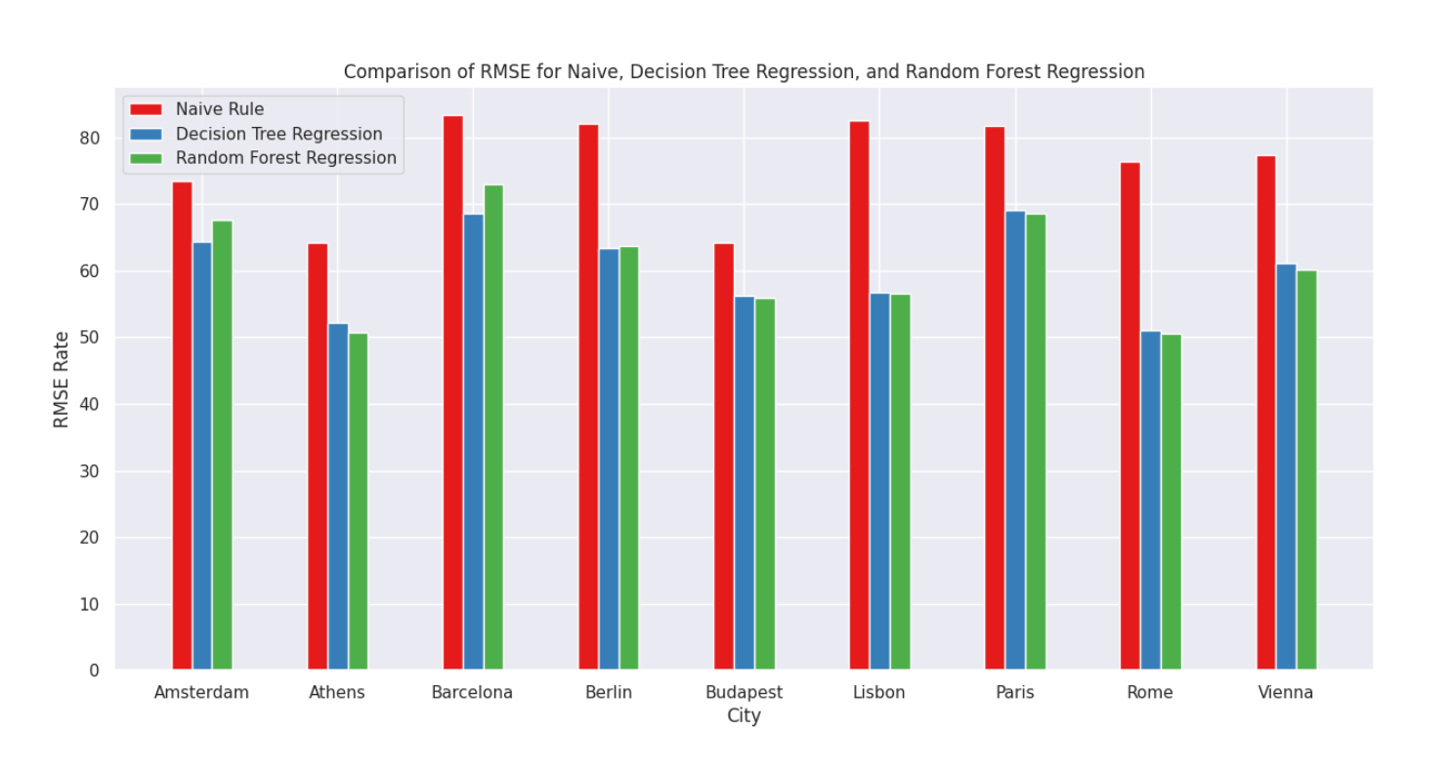

3
Price Prediction
Analysis: Model Comparison via RMSE
Prediction Models Tested
Regression Decision Tree
Interpretability
Regression Random Forest
Higher accuracy rates
Naive Rule used as comparison benchmark
Primary model is random forest regressor
6/9 times performs with less error

Slide 23
3
Price Prediction
Analysis: Feature Importance per City
Amsterdam
Restaurant Index
Attraction Index
City Center (km)
Athens
Attraction Index
Bedrooms
Person Capacity
Barcelona
Restaurant Index
Person Capacity
City Center (km)
Berlin
Restaurant Index
Person Capacity
City Center (km)
Budapest
Bedrooms
Private Room
Attraction Index
Lisbon
Private Room
Bedrooms
Restaurant Index
Paris
Attraction Index
Person Capacity
Cleanliness Rating
Rome
Restaurant Index
Private Room
Person Capacity
Vienna
Private Room
Attraction Index
Person Capacity

Slide 24


3
Case Study
Case Study Introduction
Isabella
Paolo
What should these new Airbnb owners charge to rent out their apartment for the night?
Notes:
anna

Slide 25
3
Case Study
Case Study Continued
What‘s the Same?.
What‘s Different?.
In Rome!
1.2 km away from the city center, 0.9 km away from the metro, with a normalized restaurant and attraction index of 6.2
Entire two bedroom apartment with a capacity to sleep four
10/10 cleanliness rating
Price determined for a weekend day
Restaurant index is #1 importance feature in Rome
Avg. 25
Paolo’s apartment has a normalized restaurant index of 6.2
Isabella’s apartment has a normalized restaurant index of 50
Notes:
anna

Slide 26
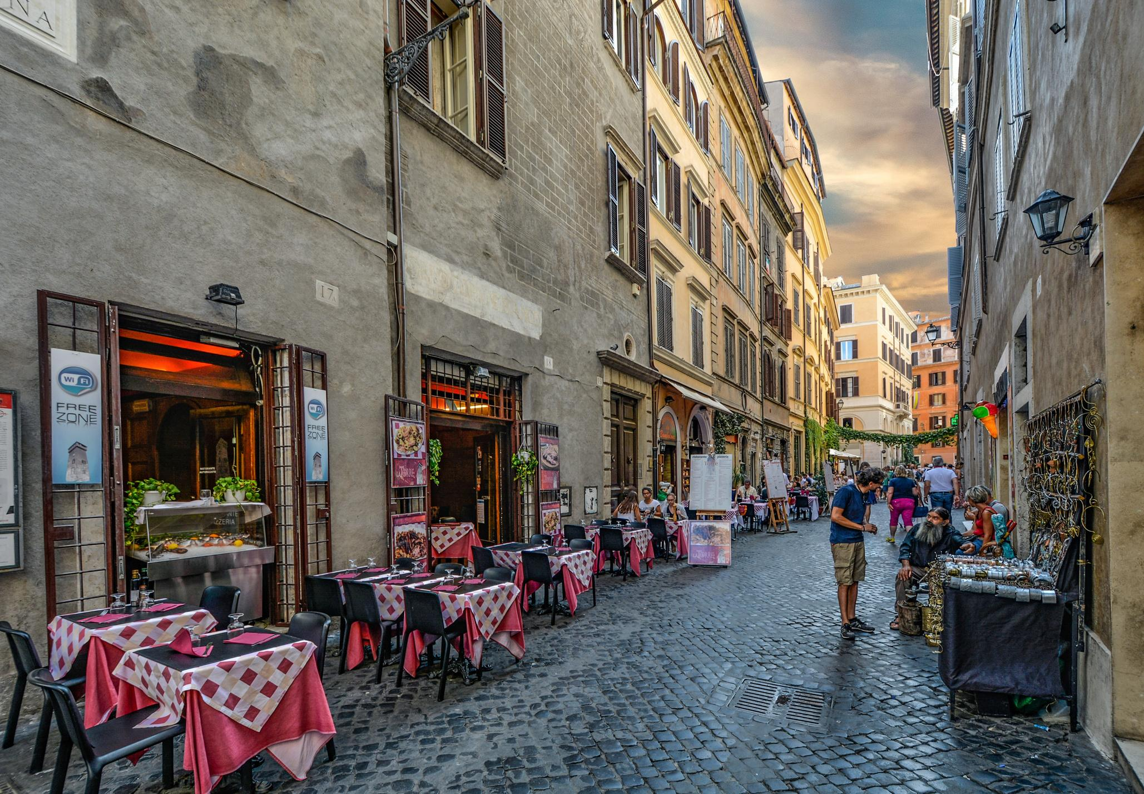
3
Case Study
Case Study Continued
Features entered into our recommendation algorithm
Isabella’s Predicted Price:
$233.62 USD/night
Paolo’s Predicted
Price:
$210.14 USD/night
Notes:
anna

Slide 27
Final Thoughts and Recommendations

Slide 28
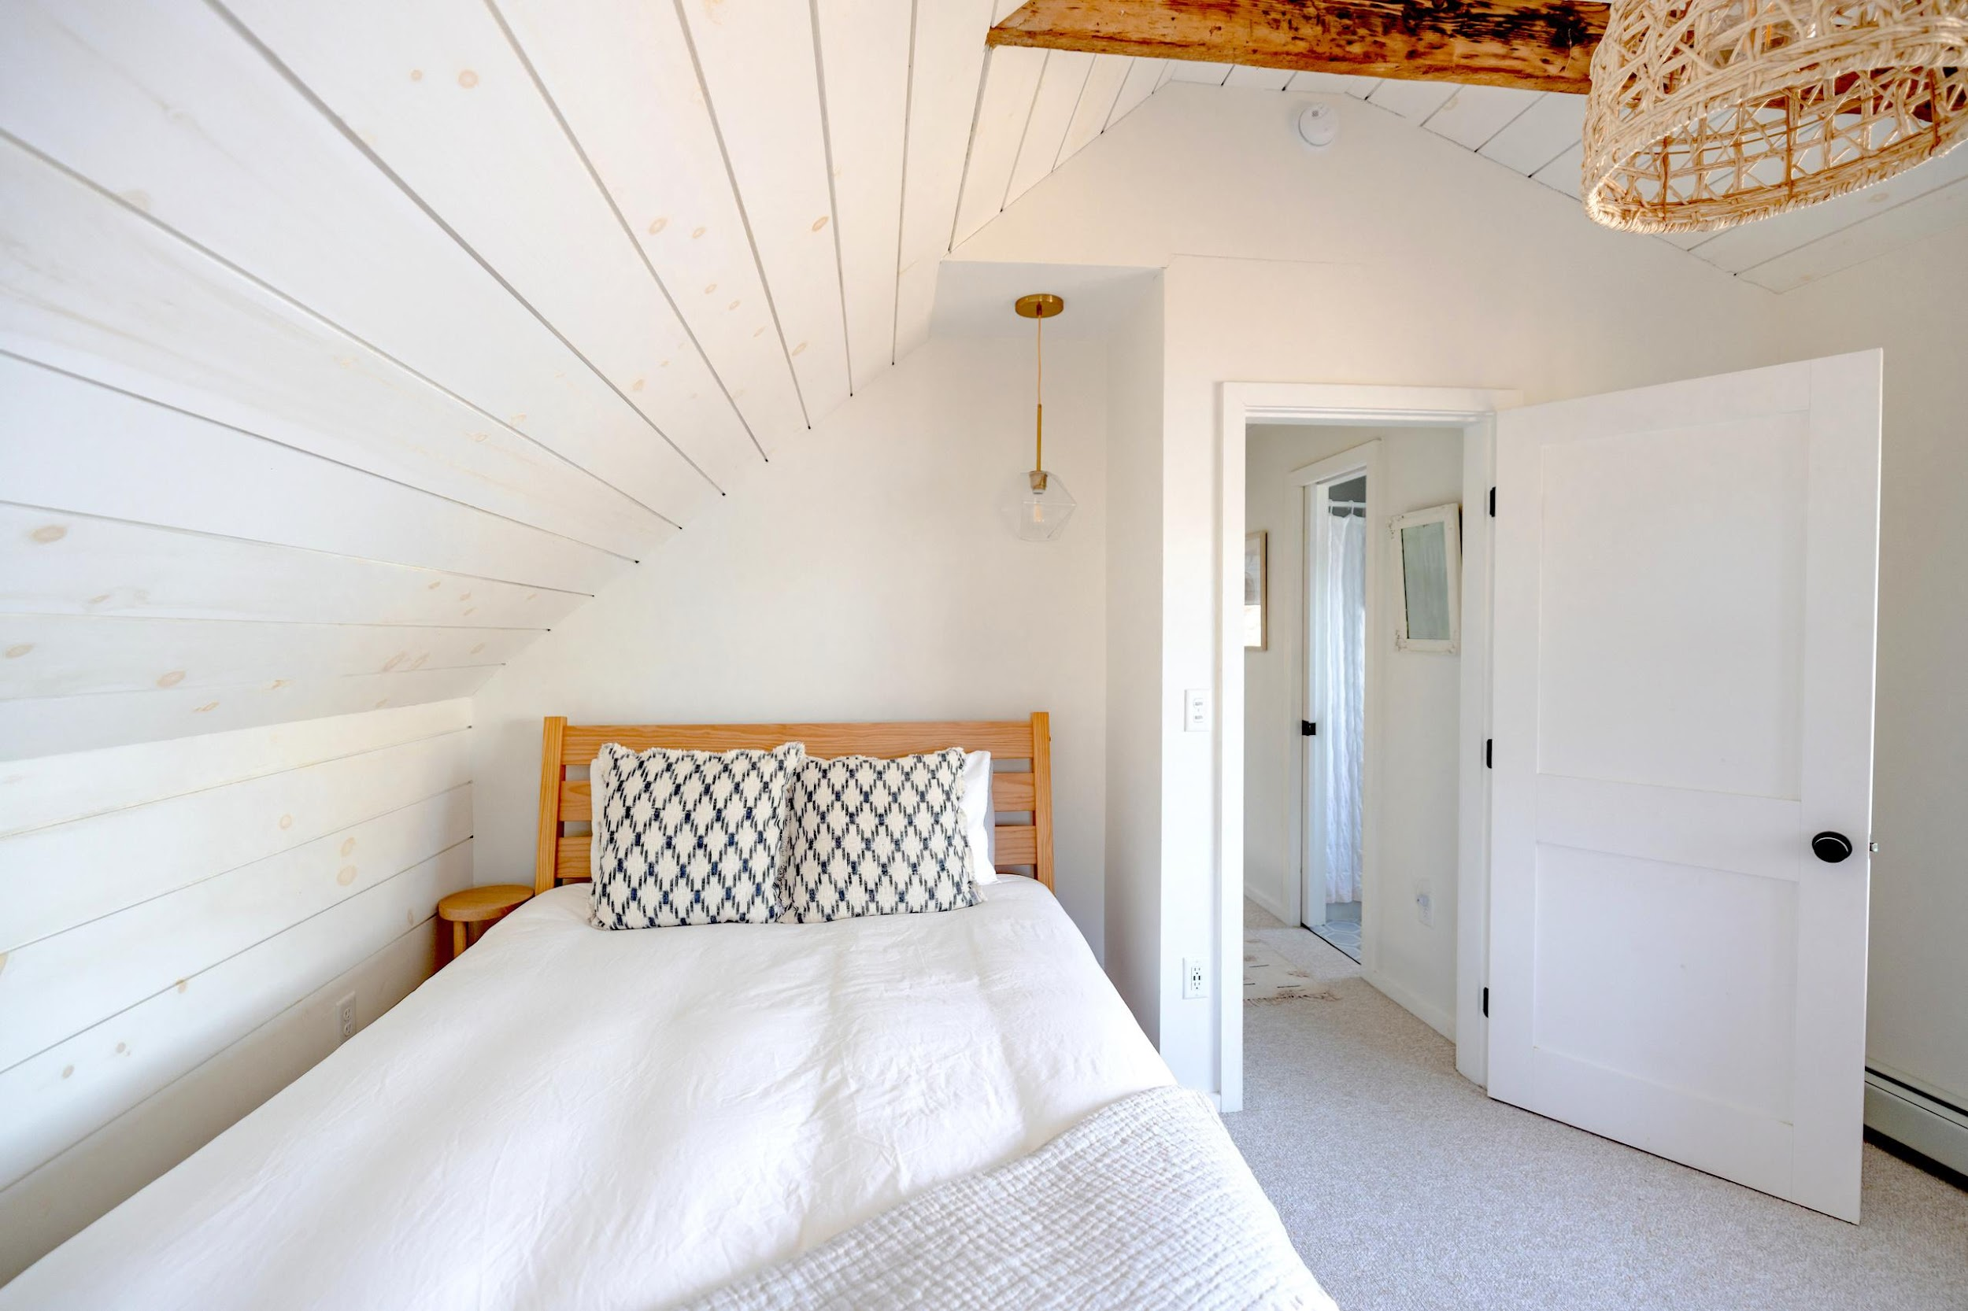
4
Recommendations
Recommendations for Airbnb Owners
Guest Satisfaction and Competitive Price
Have an understanding of the local culture and what is important in your desired area
Search for areas with many good restaurants and attractions, while trying to maintain a close distance to the city center
Specifics
Guest Satisfaction
Regularly clean property to increase cleanliness rating
Price
Invest in properties with private rooms and space for guests
Importance of Features
High guest satisfaction can lead to a superhost status, leading to higher profits
competitive pricing makes your listing more attractive, generating more bookings and revenue
Notes:
cole

Slide 29


THANK YOU!
Any questions?
Calle Cualquiera 123, Cualquier Lugar

